Slide 1

Implementing and Troubleshooting hybrid join with Windows 365
Niall Brady and Paul Winstanley

Slide 2


Niall Brady
@ncbrady
windows-noob.com
Enterprise Mobility MVP

Slide 3

Paul Winstanley
@sccmentor
SCCM Solutions Ltd
sccmentor.com
Enterprise Mobility MVP

Slide 4
Agenda
Introduction
Implement
Troubleshooting
Implementing and Troubleshooting hybrid Windows 365

Slide 5

Introduction
Windows 365 Blog Series – 10-part series
Getting started with Windows 365 - Part 1. Introduction - Windows 365 - www.windows-noob.com
Hybrid Join Windows 365
Getting started with Windows 365 - Part 3. Provisioning a Hybrid Azure Ad Joined Cloud PC - Windows 365 - www.windows-noob.com

Slide 6
Hybrid Join v Azure AD Join Windows 365
 | Hybrid Join | Azure AD Join
Device Management Sources | Group Policy/Intune/ConfigMgr | Intune / ConfigMgr
Network | Line of sight to on-premise required | Line of sight not required
Device Objects | On premise and synched to Azure AD | Azure AD
Group Objects | On premise and synched to Azure AD | Azure AD
User Objects | On premise and synched to Azure AD | Azure AD
Setup | Complex to set up | Easy to set up
Applications | Supports legacy apps not yet cloud ready | Work may be required to update legacy apps
Network | Cannot use the Microsoft managed VNet | Use the Microsoft managed VNet

Slide 7

Requirements
Provisioning Requirements:
Permissions to grant
A reader role on the subscription.
Network contributor permissions on the resource group.
A network contributor role on the vNet.
AAD & Intune Requirements:
Valid tenant
Allow corporate enrollment
Configure the infrastructure for domain join
Cloud sync on-premise devices
Domain & Licencing Requirements:
Specify OU for domain join and assign rights to create objects in it (domain join)
User accounts in on-prem and synched to cloud
Intune licence to manage and users require to use

Slide 8
Azure Networking Components
Resource Group
Virtual Network
Virtual Network Gateway
Local Network Gateway
VPN Connection
Local Networking Components
Local VPN – RRAS or equivalent
Routing

Slide 9


Implementing hybrid join Windows 365

Slide 10

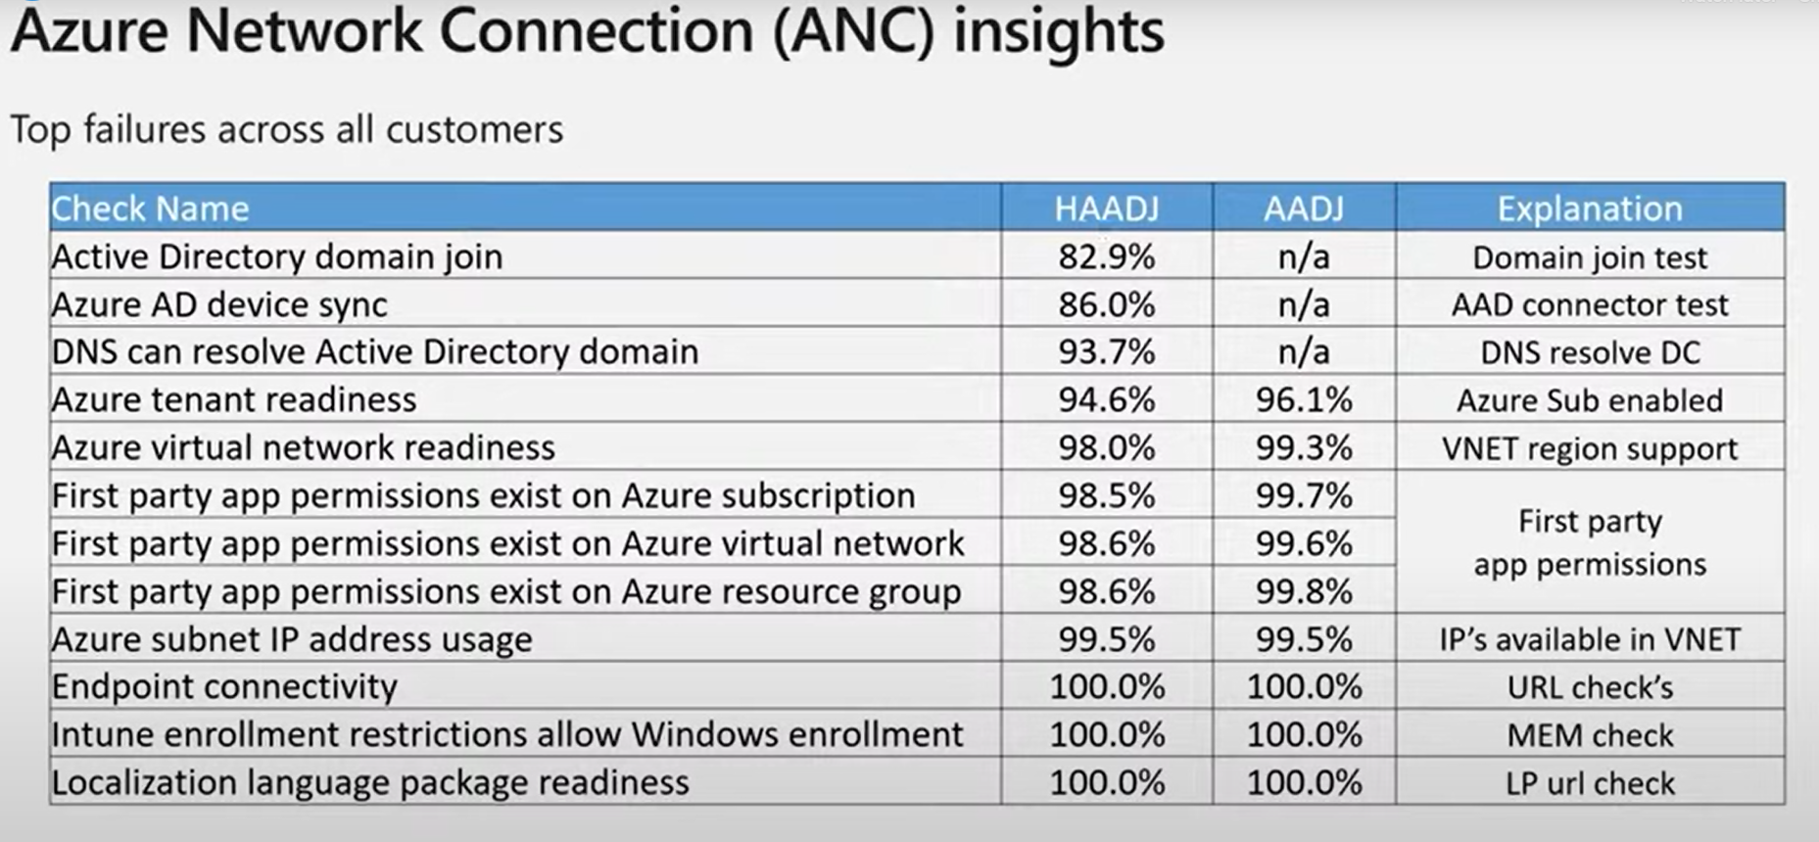
Troubleshooting

Slide 11
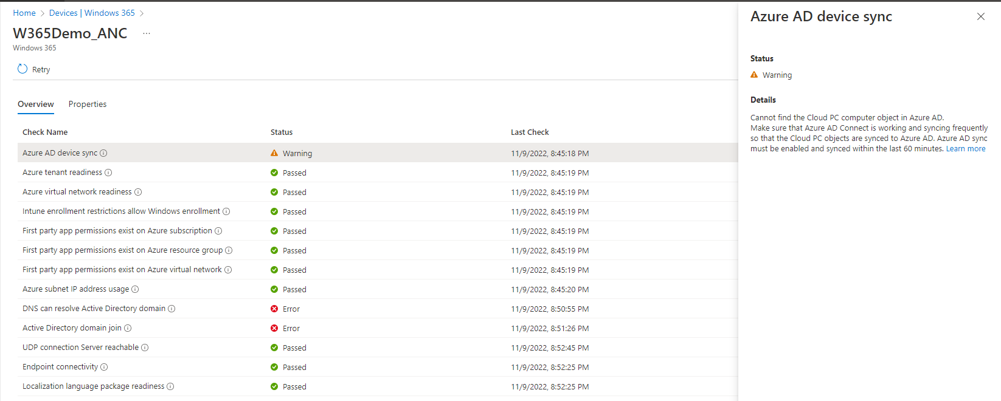
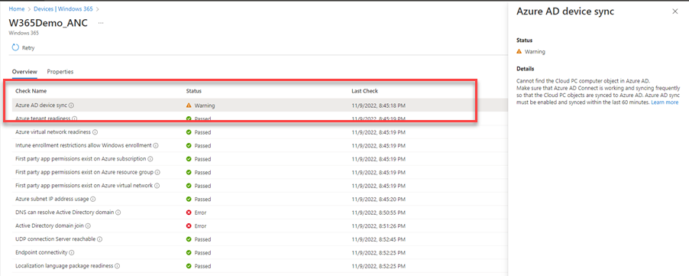
AAD Sync

Slide 12
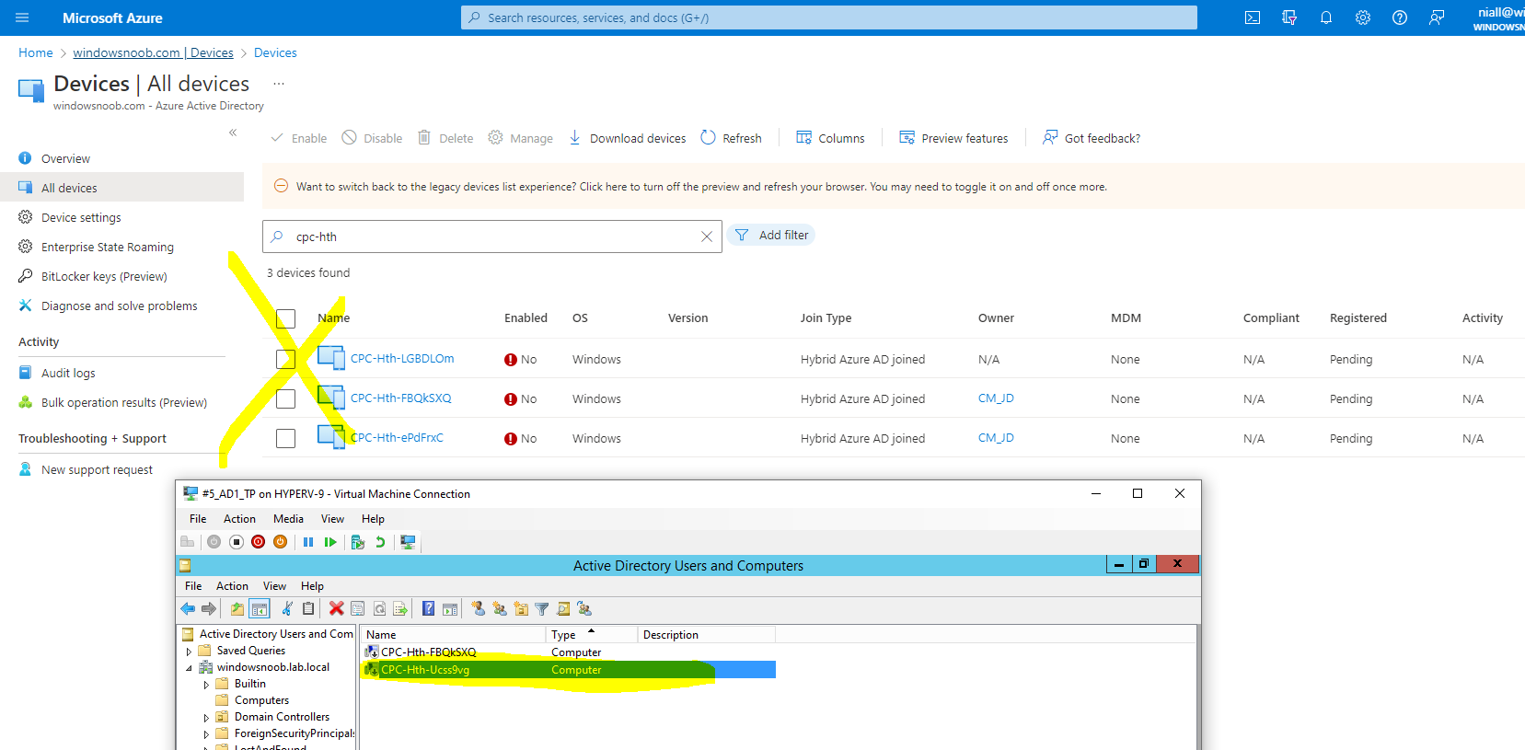
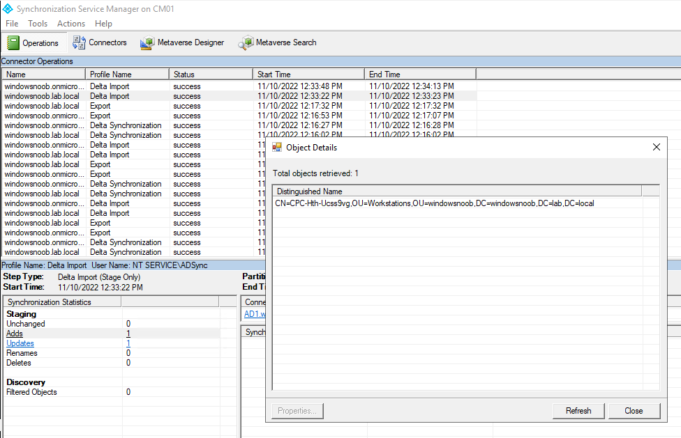
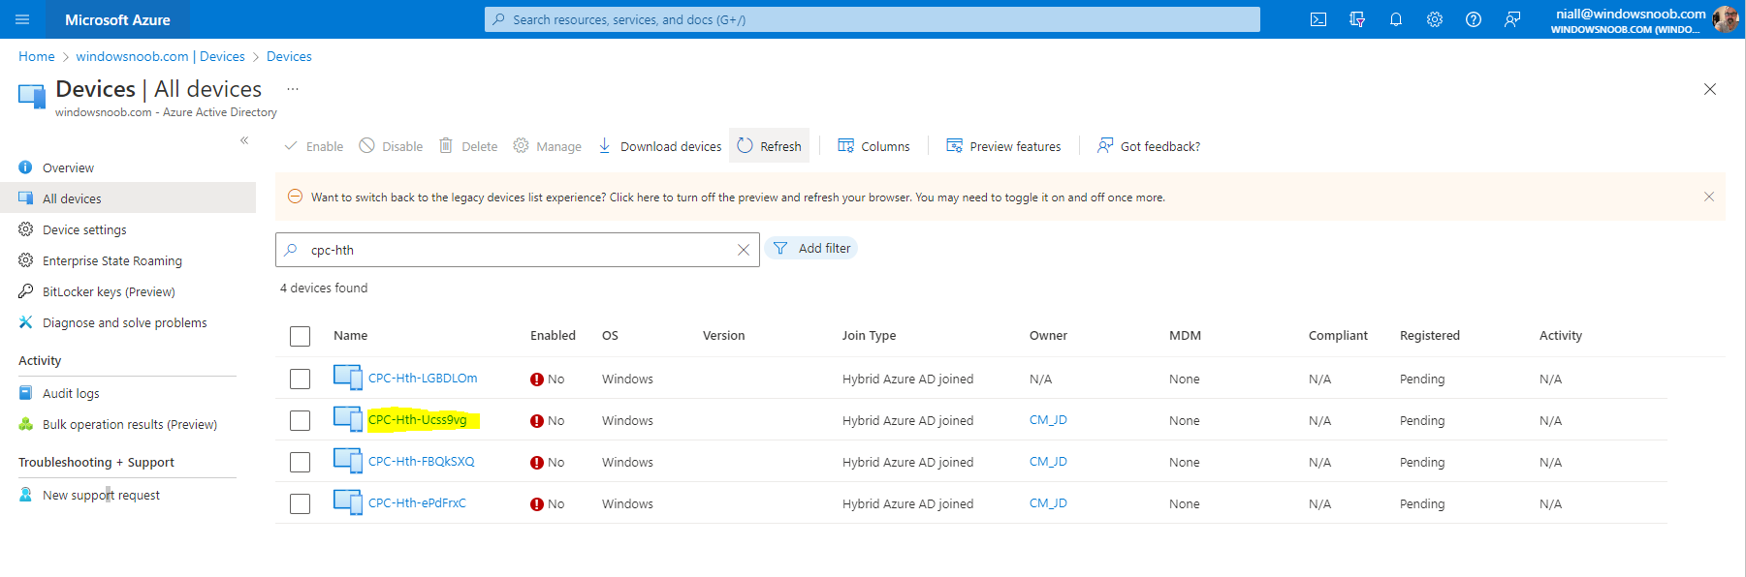

Slide 13
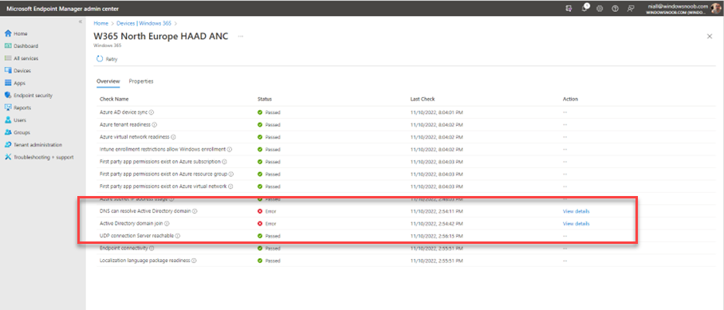
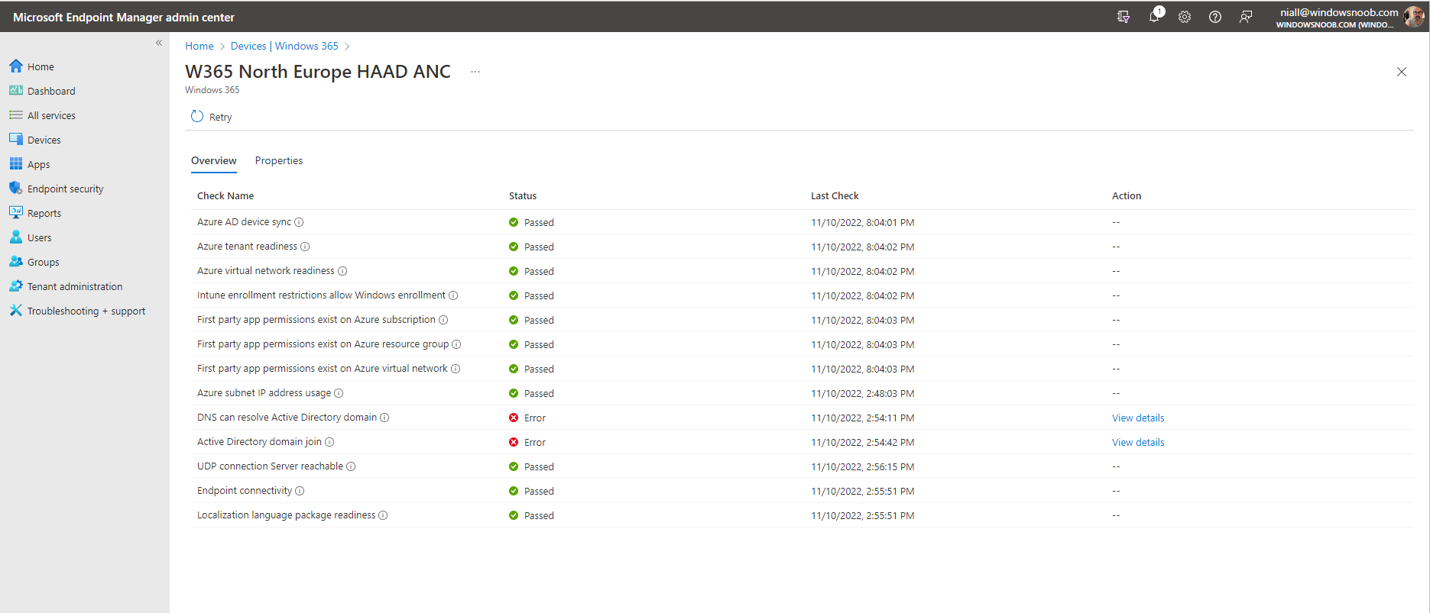
Domain join or DNS

Slide 14
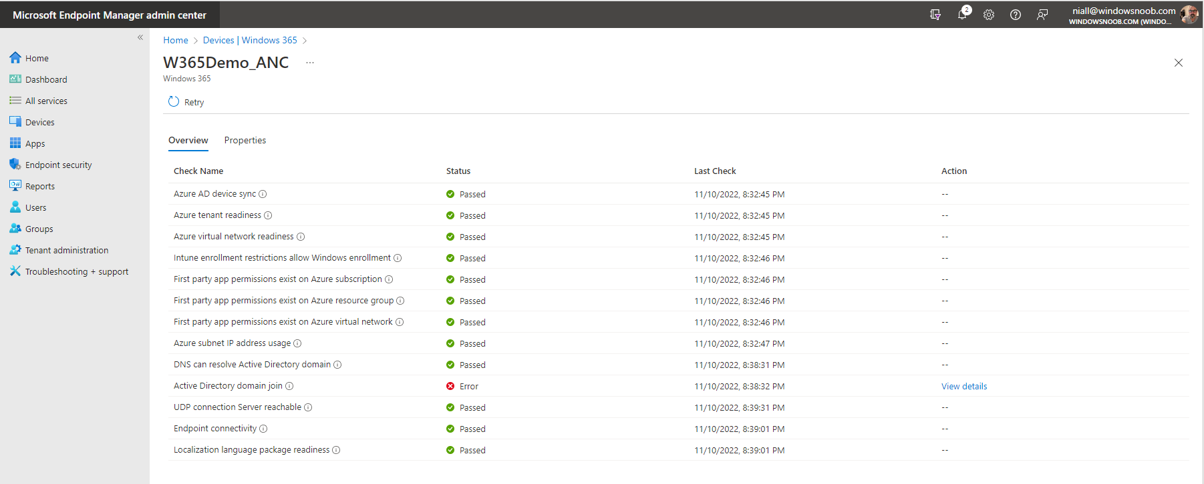
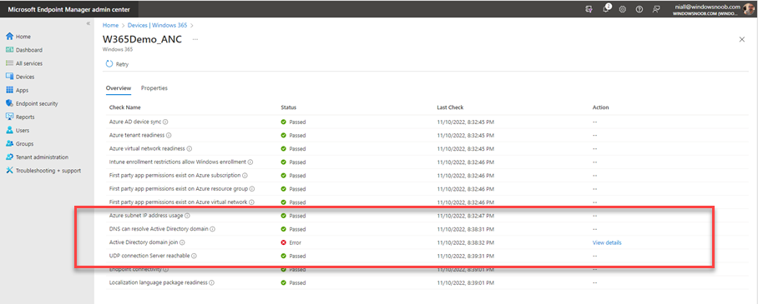
Active Directory join

Slide 15
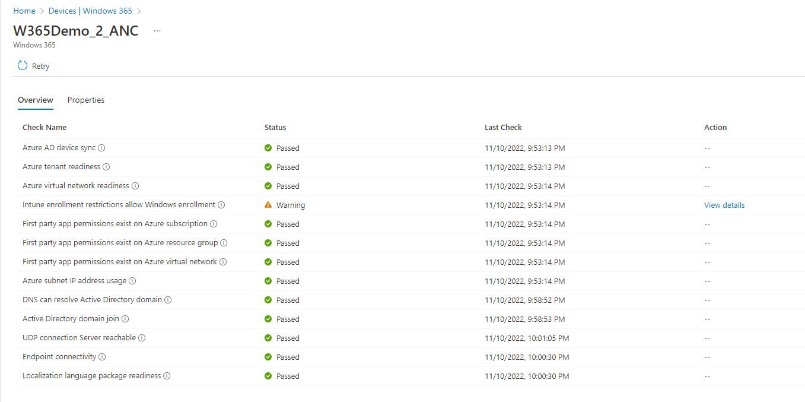
Enrollment blocked

Slide 16
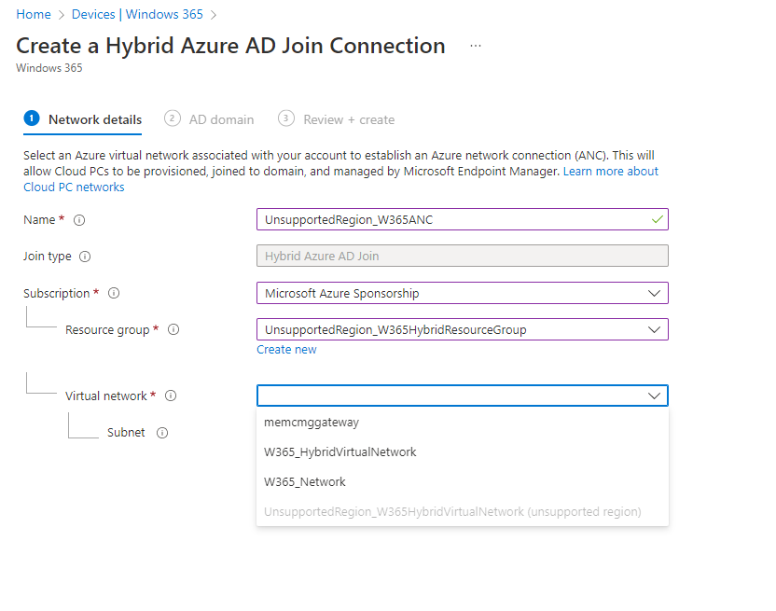
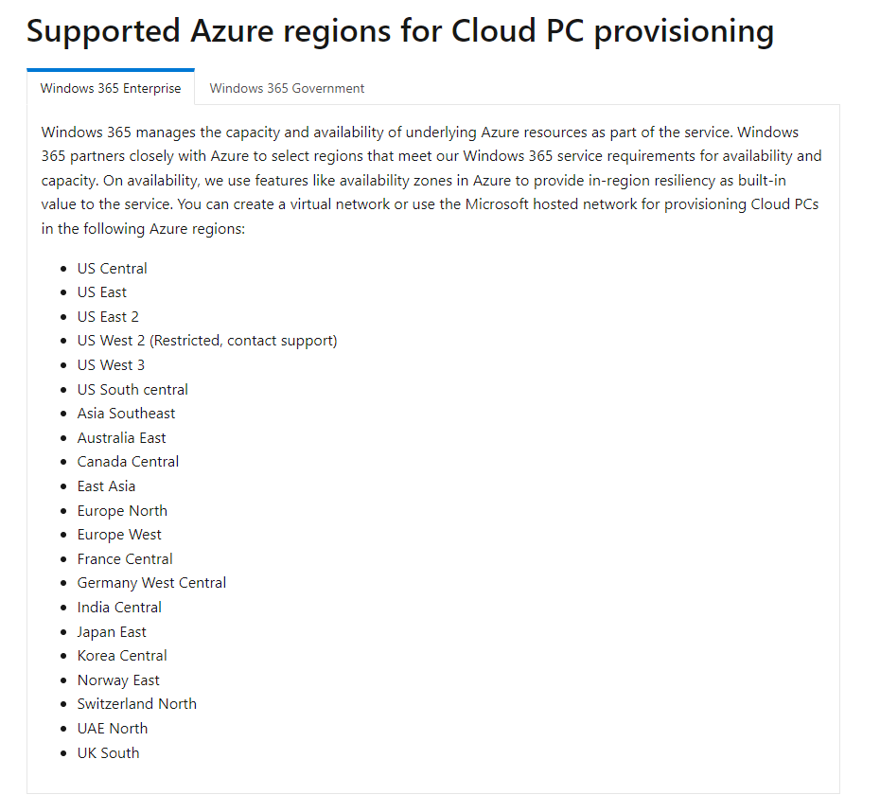
Azure regions

Slide 17




Thank you

